Slide 1
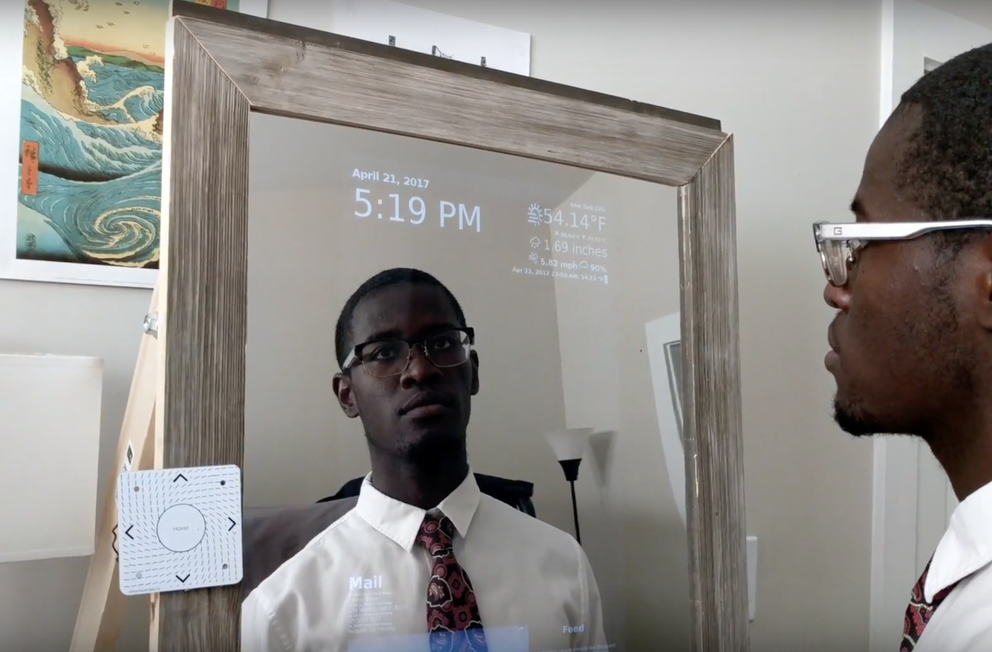
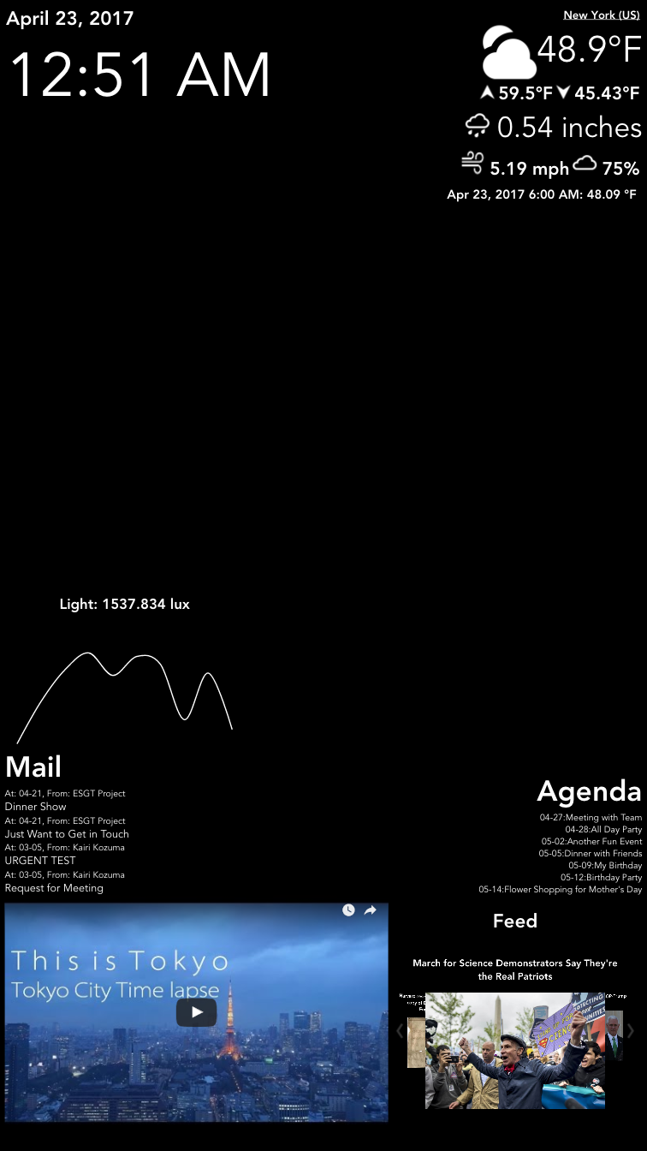
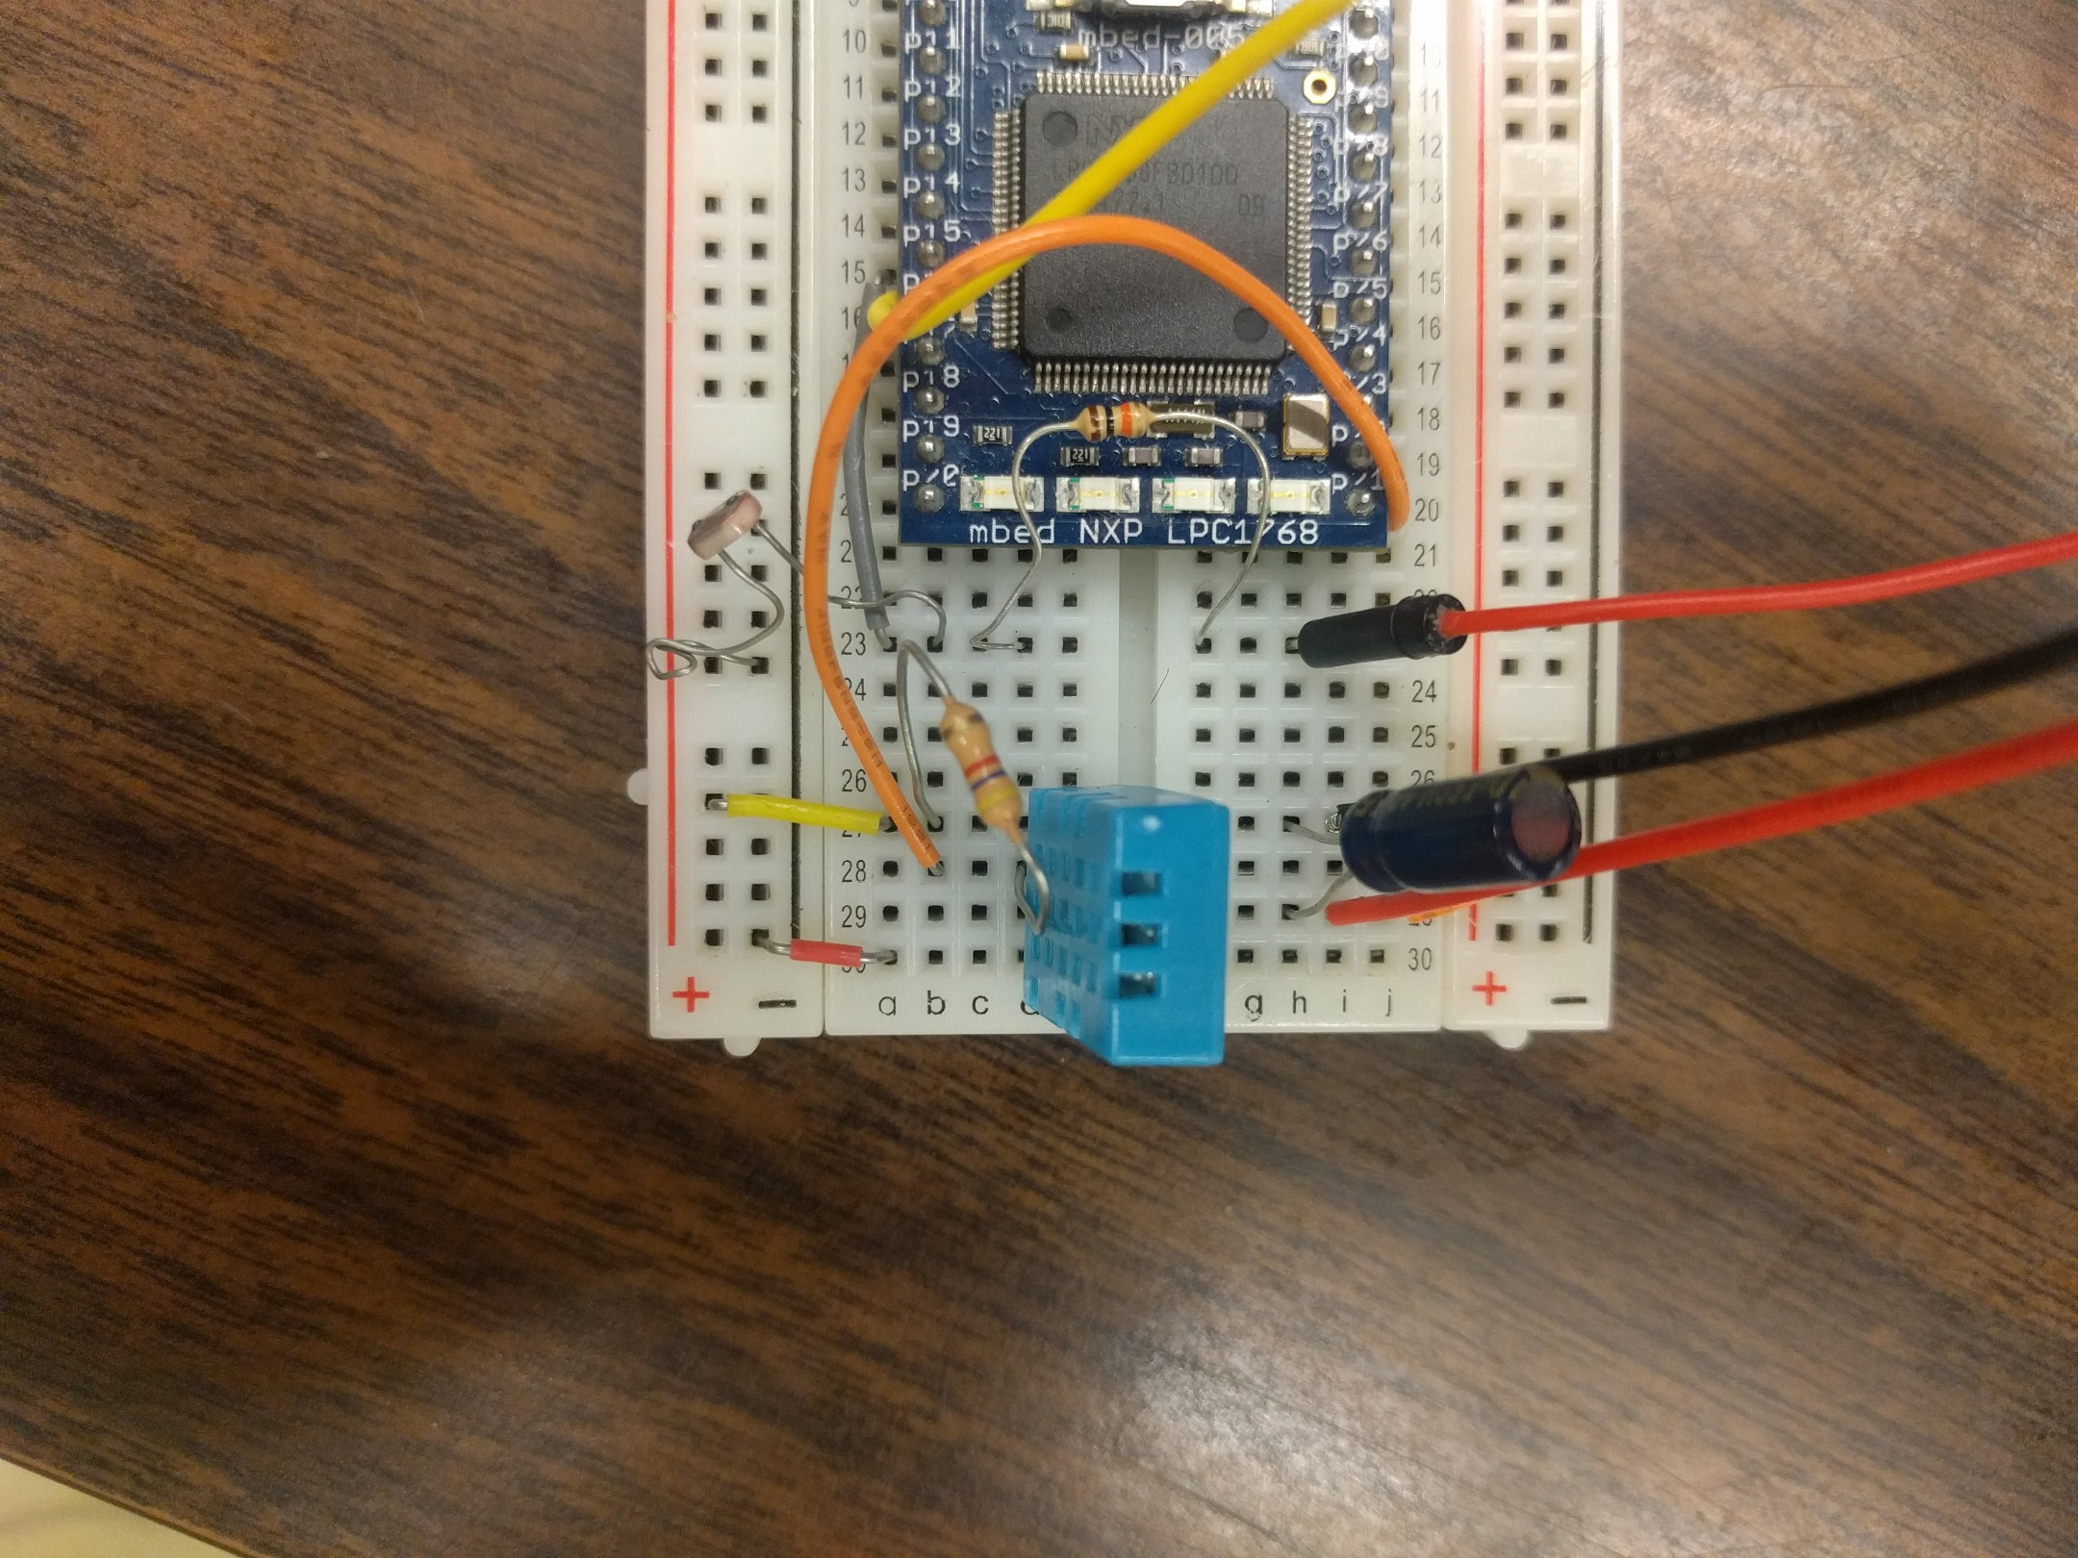
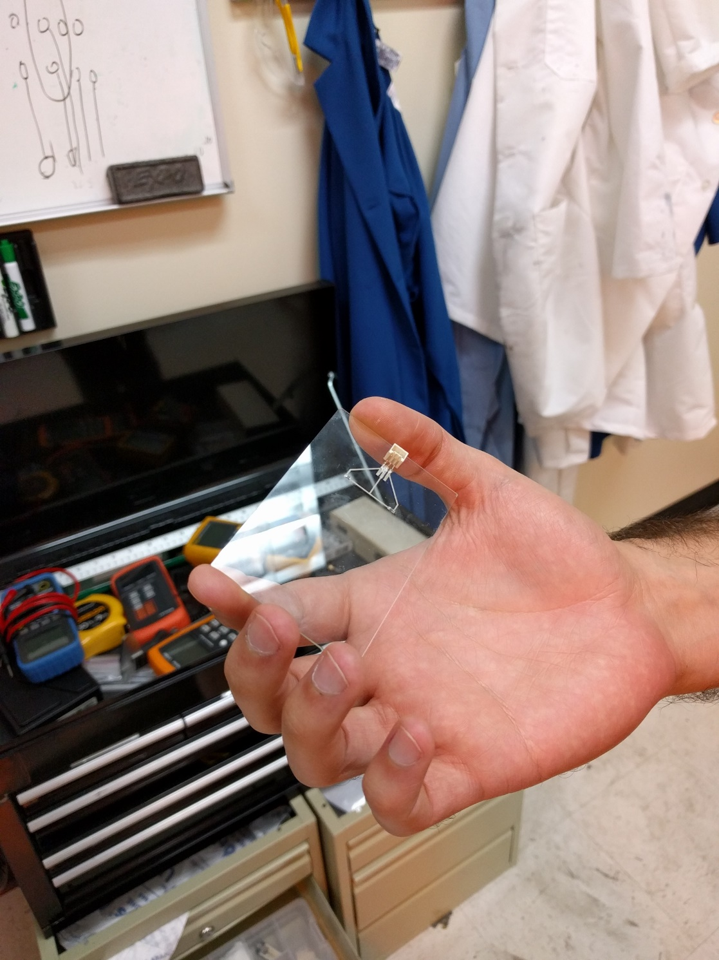
ESGT for Smart Glass Technologies
ATHENA
Najee Kitchens, Kairi Kozuma, Boa-Lin Lai, Jonathan Osei-Owusu, Nishant Shah
Section ET2, The Magicians
Project Advisor: Dr. Manos Tentzeris
Background
System Design
Final Prototype
About 610,000 people die of heart disease in the U.S. each year (1 in every 4 deaths)
Integrating important information into daily routine doesn’t require a change to the routine
Modular design is capable of adapting to a variety of applications (i.e. mirror, windshield, window, etc.)
Phone: Android app for connecting to Firebase for user configuration
Database: PostgreSQL DB for storing sensor data for future use
Sensors: IR, temperature, and humid sensors (include biometric in future work)
Firebase: Cloud backup and synchronization of user configuration
RPI3: Microcontroller for the web browser, database, and analog sensor input
User API: The service for email, news feed, weather, calendar, etc.
Mirror: Frontend and display for ESGT
Hover: Gesture sensor for user interaction
Objectives
Display multiple applications in one dashboard (i.e. calendar, mail, time, weather, sensor data, biometric vital signs)
Control display without smudging it
Integrate transparent circuitry (i.e. LCD, sensors) into different display materials (i.e. mirror, glass, plastic)
Results
Conclusion
Dataflow Results
Collect and stores real-time sensor data into database
User configuration changes update instantly on mirror
Supports multiple devices and users
Software ecosystem implementable on variety of products (i.e. eyeglasses, window)
Shows / hides widgets, depending on user’s desired settings
Allows HMI without smudging display
Solutions
Hardware Configuration Results
Hover for gesture input
Use RTOS to reduce responsive delay
Transparent Circuitry Results
Future Work
A “smart” mirror prototype:
Interact via Hover gesture sensors
Synchronize data to Android application
Appearance of normal mirror when off
Display real time sensor input
Personalized email, news, weather, and calendar information
Integrate transparent circuitry into two-way mirror, glass, flexible glass etc.
Add biometric device to detect vitals (i.e. blood pressure)
Add device to detect close proximity to turn on and off the display
Use more conspicuous gesture sensor
Attached 2 surface-mounted resistors + power supply + light + humidity / temp sensor
Proved concept of inkjet printing on glass

